Slide 1

STAFF ORIENTATION

Slide 2
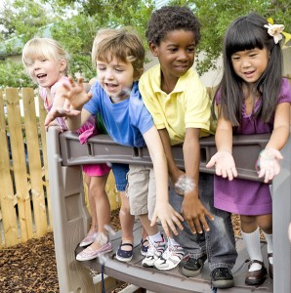
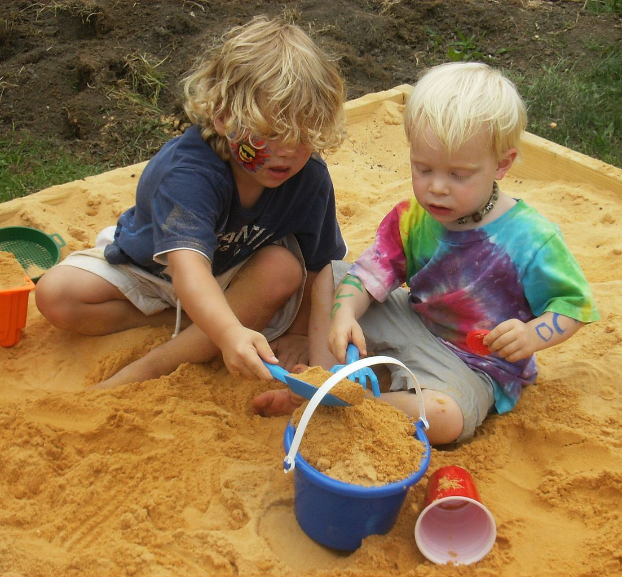
Active Learning Environment
The Outdoor Playground
Keeping the children safe while they play outside is a very important job. Please remember that your classroom ratios are the same on the playground as they are in the classroom. SUPERVISE AT ALL TIMES! Please make sure there is a teacher posted on each side of the playground. We want to monitor the gate to be sure no one leaves the safety of the fenced-in area.

Slide 3
Active Learning Environment
Another significant issue of importance on our playground is our attentiveness to the entrance and exit of the playground. Children enjoy working the push bar on the gate, so keep a close eye on them!
Parents must be greeted the minute they enter the playground. This way we can ensure that the person picking them up is actually an authorized pick-up person. This also allows us to communicate with that parent regarding the location of their child, and how their day was. This is a very important time of the day for a parent and their child.

Slide 4
Active Learning Environment
Outside times are scheduled at different points of the day, with different times for each class. This way, it is not always a struggle between the children to negotiate for the use of the same equipment.
Please know when your classroom has the playground reserved and respect the rights of playground time for the other classrooms.
If you find that another classroom is consistently infringing upon your children’s outside time, try discussing it with the other teacher. If you need help, please tell one of the administrative staff members and we will help you.

Slide 5
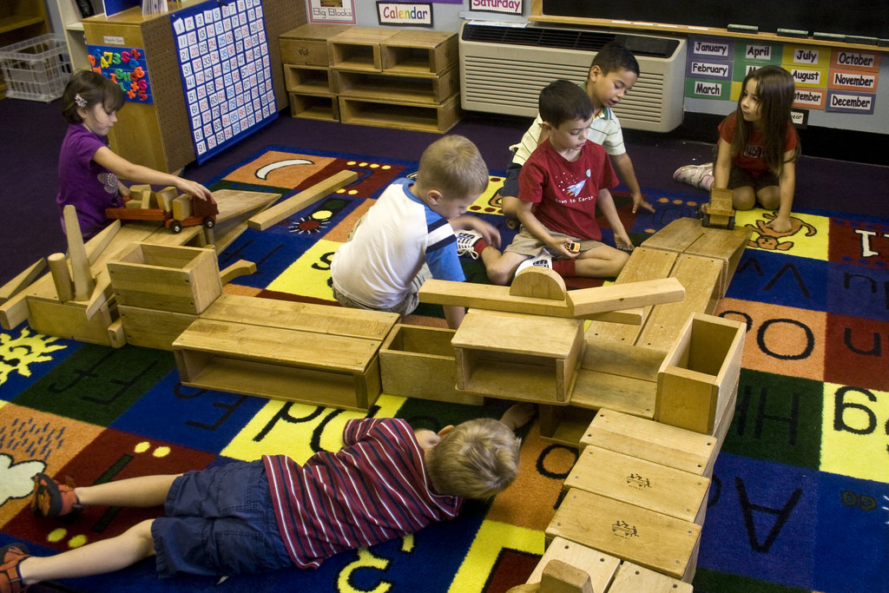
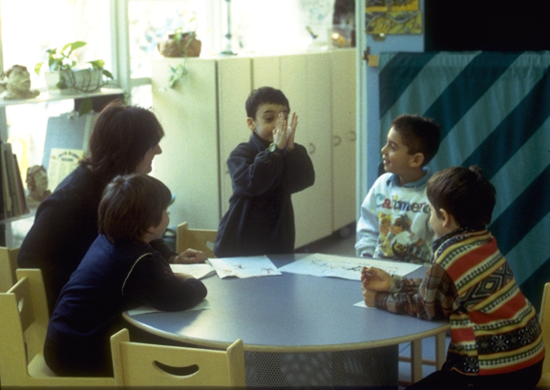
Active Learning Environment
The Indoor Classroom
Each classroom has a lead teacher and some have assistant teachers. The lead teacher is responsible for ensuring that lesson plans are created and followed with support from the assistant teacher. We use the Wyoming Early Learning Guidelines (infants and toddlers) and Foundations (preschool) to organize our emergent learning into an intentional curriculum that meets the developmental needs of our children. By creating project-based studies centering around children’s interests we are able to make sure children’s days here are engaging AND supportive of their learning.
We draw help from the Emergent, Reggio Emilia, project based curriculum to make sure the classroom environment is also supporting their cognitive, physical, social/emotional and language/literacy development.
Once the lesson plans are developed by collecting observations, children’s interests, developmental needs, they are posted in each classroom for parents’ information. This is very important, since parents really want to know what their children are doing during their day here, and WHY!

Slide 6
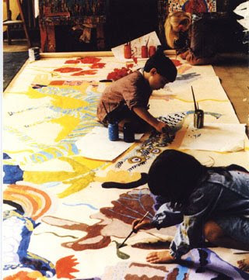
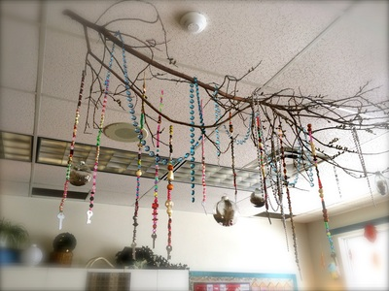
Active Learning Environment
Once appropriate activities are chosen and made available to the children, they are free to choose which centers and or invitations they will participate in and where they will stay the longest.
The children learn to make choices of their own through the use of centers and open invitations. Of course, you will need to set some guidelines. After all, the water table will only accommodate so many children before it becomes too crowded!
While the teacher should be involved in the children’s play, the teacher should not be the center focus of the day’s activities. Remember not to tell children what to think or believe, but rather ask children questions that encourage them to think about their play.
  “What do you think will happen?”
  “Why do you think that happened?”
  “What would you like to try next?”
And when they ask YOU a question, do your best to ANSWER with a question…
“What do YOU think?”

Slide 7
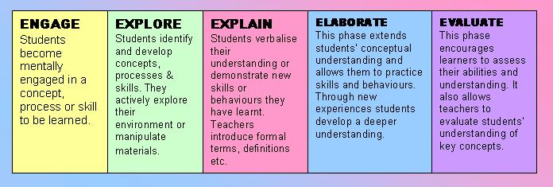
Active Learning Environment

Slide 8
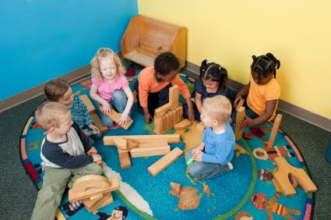
Active Learning Environment
A good preschool teacher …
Listen carefully so you can decide what they want and need.
Offer additional things that could make their experience more successful.
Watch to make sure you have provided all the materials they need.
Stand back and give them room to enjoy their experiences…BUT…
Stay nearby and attentive, just in case they need you.

Slide 9
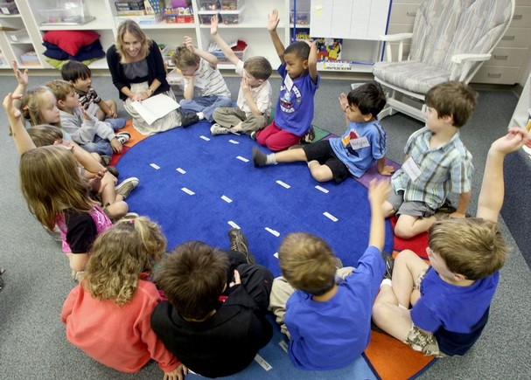
Active Learning Environment
Circle time should be interactive. This is a time for reading books, singing songs, playing group games, and having all-class discussions, charting, asking questions, role play.
Circle time should be kept short, especially until the children are accustomed to sitting still and being one of the “group.”
Infants/toddlers should not be expected to participate in circle time activities for short periods of time and not made to sit still. They can be read to ,sing songs, finger play.

Slide 10

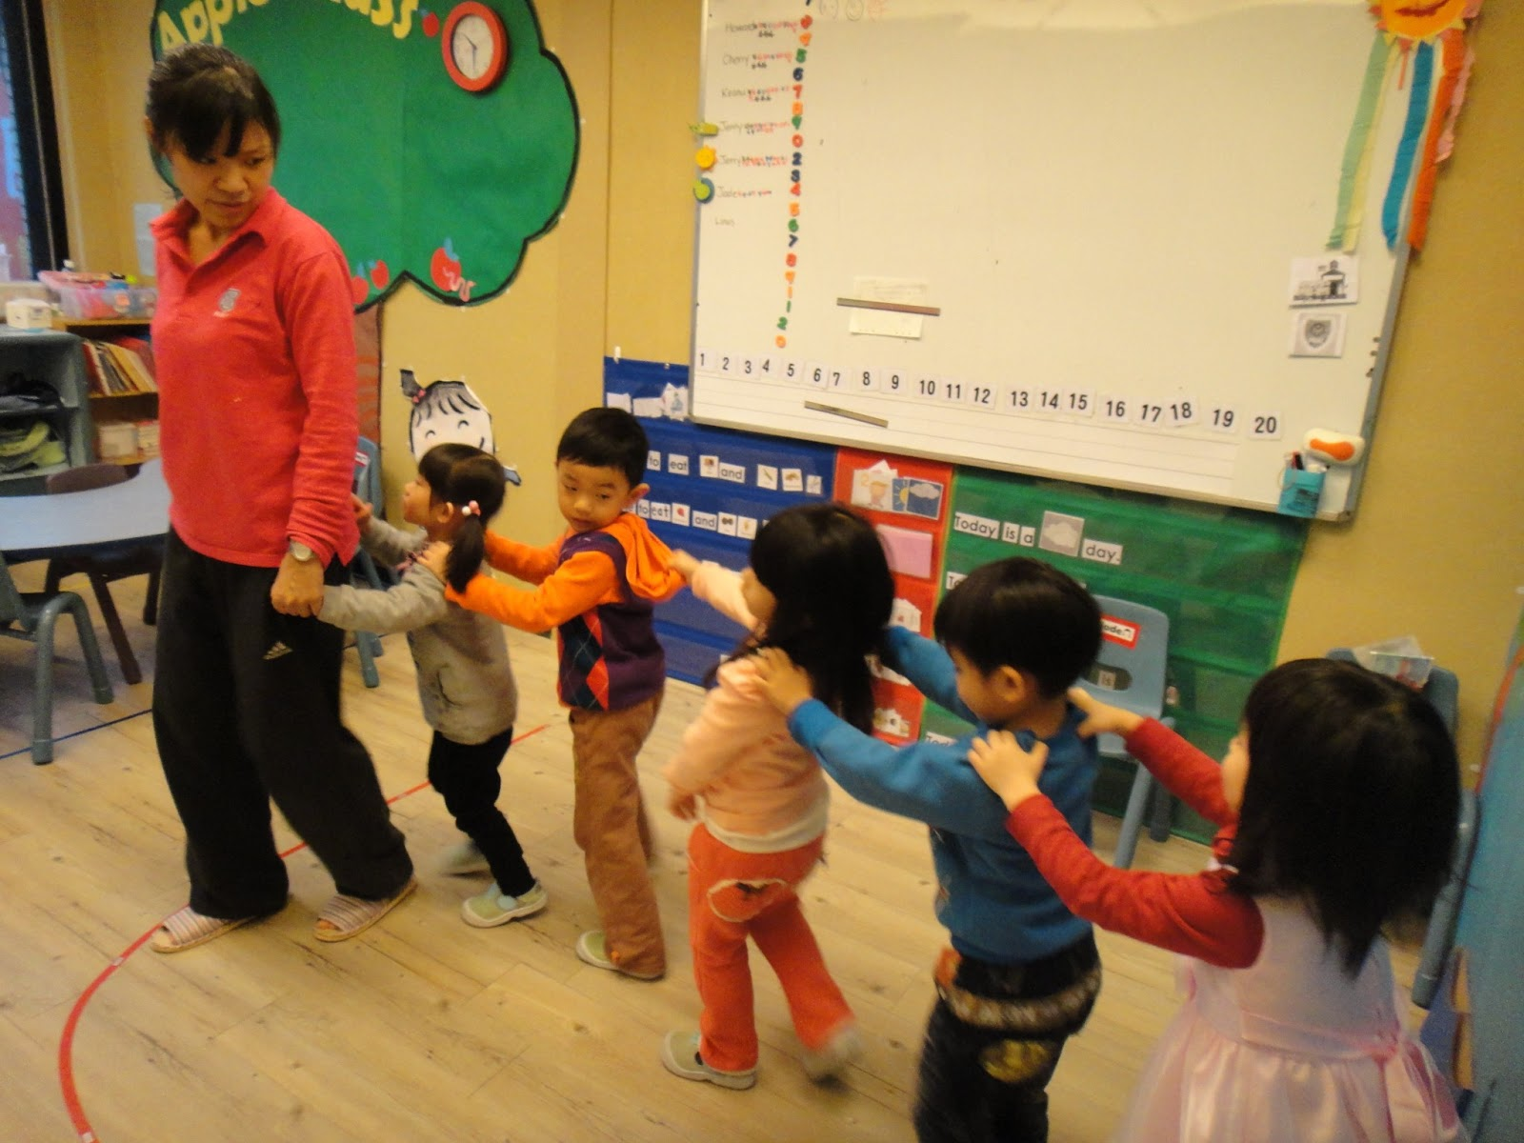
Active Learning Environment
Planning ahead is the key to a successful circle time.
Know which books you will read. Have them ready.
Children should be read to. Children should be asked questions, have the chance to participate, role play, interact with the book , teachers and peers. Children should be given choices and information to expand their knowledge.
Remember, it’s not about the children fitting into your plans.
It’s about YOU fitting into the children’s needs!

Slide 11
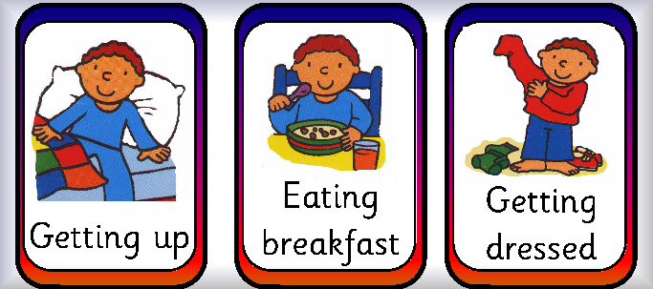
Active Learning Environment
Routines as Part of the Curriculum – Potty Training
Young children are still mastering skills such as self-feeding, pouring their own juice, taking care of their own belongings and toilet training. These routines are an important part of their curriculum, especially for infants and toddlers, although they continue even in the preschool years.
Potty-training is an important part of learning for very young children. And even older preschool children who are already “potty-trained” will have “accidents.”
Remember that this is normal and should not be grounds for punishment, berating, or humiliating, EVER.
To help children become more in control of themselves, be sure to
schedule breaks for the entire class to use the bathroom,
particularly before and after outside play.
Children who are very absorbed in interesting play are likely to forget
to go to the bathroom without reminders. Setting a timer to remind
everyone of “time for a bathroom break” will help them learn
self-regulation and save them from embarrassing accidents.

Slide 12
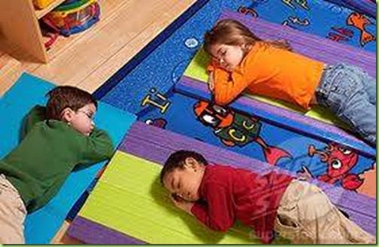
Active Learning Environment
Napping
Quiet music can help to drown out background noise and make it easier for children to rest.
Having children sleep in the same spot consistently makes the children feel more secure, and makes your naptime more likely to be successful.
Reading a story SHOULD be part of the routine. It is OKAY to give back rubs. The physical contact helps reassure them and calm them for a better nap time. Kids are NOT BEING SPOILED!
Your classroom should always be light enough for others to see what is happening
inside your room!
Not all children need to sleep.
Nap time is about the children NOT the CONVIENCE for TEACHERS.

Slide 13
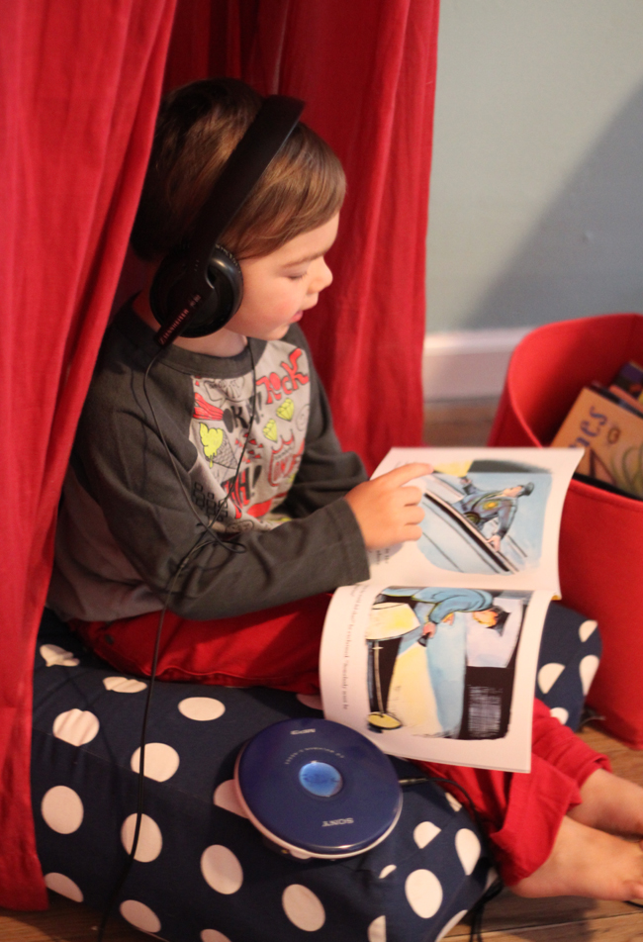
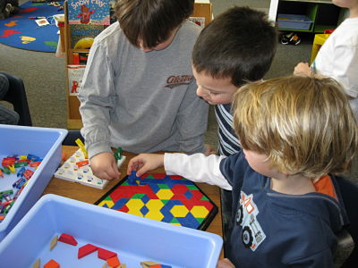
Active Learning Environment
All Children don’t need to sleep.
It is the teacher’s responsibility to have quiet activities to occupy their time, rather than asking them to be quiet and still for a very long time.
Don’t set yourself up for disaster by expecting the impossible. You wouldn’t like it if someone wasted over an hour of your time and wouldn’t let YOU do anything else.
This is also a great time to get in a little one-on-one time with a child. EVERYONE benefits from a little cuddle time, you know!

Slide 14


Active Learning Environment
Always remember that if you take the time to get the children settled in at nap, the resulting quiet and peace you receive will be well worth your efforts. Give them 100% of your attention until they are asleep or resting. Then you can take a mental break, as well. No sleeping on the job, though!

Slide 15
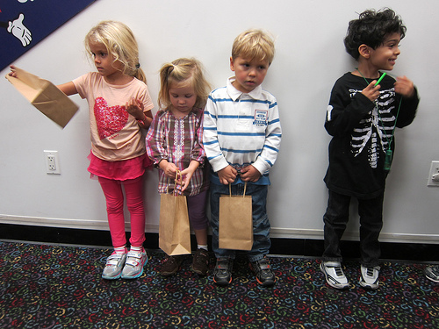
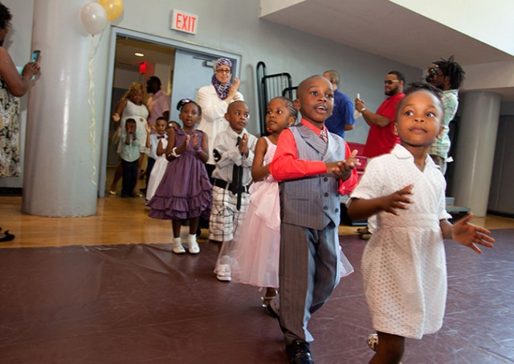
Active Learning Environment
Transitions
When you are ending one activity and beginning something else, be sure to warn the children. They need time to finish what they are doing (or playing) so they can be prepared for the next thing to come.
Warn them several times - “Only five more minutes until outside time!” “ Only two more minutes until outside time!” Only one more minute until outside time!” “It’s time to go outside!”
Pay special attention to the child in your classroom who has a particularly difficult time with transitions. There is at least one of them in every classroom! A personal warning for
that child will save you both from a stressful time.

Slide 16
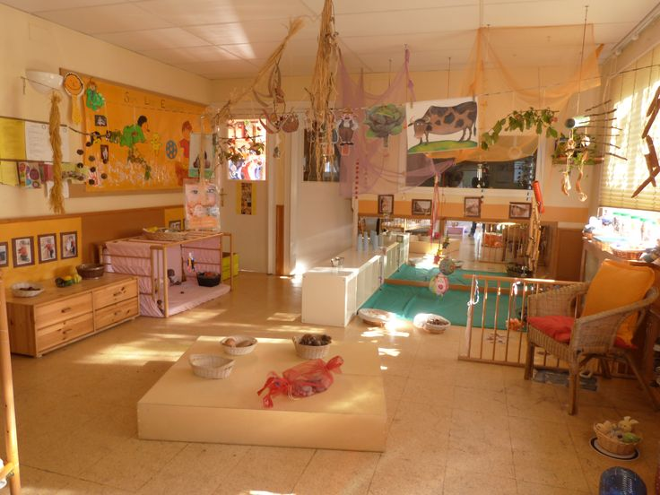
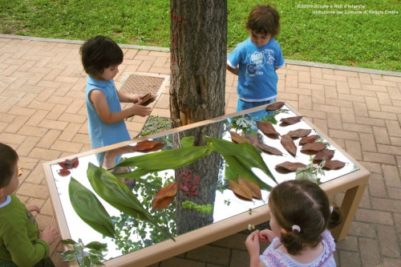
Active Learning Environment
Remember:
an environment is more then Physical space-the flow of the room, attitude and tone of adults, lighting ,colors, perceptions, furniture.
Physical space should be warm and inviting, child focused.
Learning environment should be developed with a purpose, child lead through their interests and observations.
Filled with invitations, experiments, open ended questions. Teachers and children should be researchers in their learning environment.

Slide 17
Active Learning Environment
Quiz
What are the important factors for children on the playground?
Do we have a playground schedule?
What do we use to develop lesson plans?
What type of questions should we be asking children?
What type of things should happen in a circle time?
Can babies and toddler’s have a circle time? Is different then preschooler? If so how is it different?
Explain what transitions are.
Why is it important to have a routine for those transitions?
Do all children need to take a nap?
What should children do if they don’t nap? How long should children wait ,who don’t sleep, before then can start a quiet activity?
What makes up the active learning environment?

